Slide 1
DSCI 6011-2: Deep Learning
Team Members
1. Nagabalareddy Dandala
2.Sai Ganesh Ramesetti
3.Cholayaswanth Kumar Golla

Slide 2
Project Topic
Real-Time Face Recognition System using Deep Learning

Slide 3
Project Objectives
Develop a deep learning model architecture for real-time face detection and recognition, utilizing convolutional neural networks (CNNs) for feature extraction.
Implement state-of-the-art deep learning algorithms such as ResNet, VGG, and EfficientNet for face representation, comparing their performance, achievements, and limitations in real-time scenarios.
Explore transfer learning techniques using pre-trained models on large-scale face recognition datasets like CelebA, LFW, and CASIA-WebFace to improve model accuracy and generalization.
Develop a user-friendly interface using tools like Flask or Django for inputting live video feeds and displaying real-time recognition results.

Slide 4
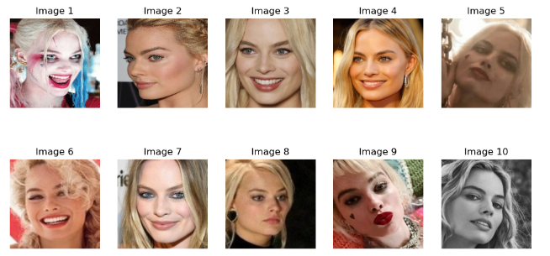
Datasets
Data Collection and Preprocessing: Gather a custom dataset comprising diverse facial images with varying poses, expressions, and lighting conditions from Kaggle (https://paperswithcode.com/sota/face-recognition-on-lfw). Preprocess the data with normalization, resizing, and augmentation techniques

Slide 5
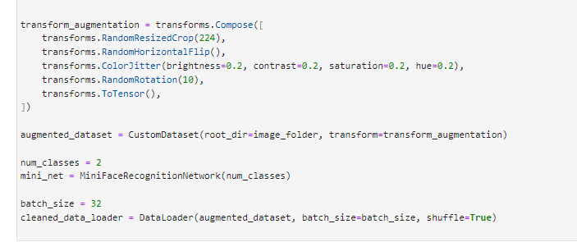
Data Processing

Slide 6
Model 1: MiniFaceRecognitionNetwork
. The MiniFaceRecognitionNetwork is a compact deep learning model tailored for real-time face recognition tasks. Its architecture typically comprises convolutional layers for feature extraction, followed by pooling layers to condense spatial information. Fully connected layers interpret these features, possibly culminating in an embedding layer that generates high-dimensional feature vectors representing input faces. Utilizing non-linear activation functions like ReLU fosters the network's ability to discern complex facial patterns. During training, it learns to minimize a chosen loss function, often triplet loss, ensuring that embeddings of the same person's faces are close while those of different individuals are distant in the embedding space. This network's compact design, coupled with its capacity for rapid inference, makes it well-suited for deployment in real-time applications where computational resources are constrained, offering efficient yet effective face recognition capabilities.

Slide 7
Model 1: ResNet-18
Utilizing ResNet-18, a pre-trained convolutional neural network renowned for its effectiveness in image classification, within face recognition involves repurposing its learned features for the task of identifying faces. By leveraging transfer learning, the network's knowledge from its original task, such as recognizing objects in ImageNet, is transferred to the domain of face recognition. This process entails fine-tuning the model on a dataset specific to faces, augmenting it with additional layers tailored for face recognition, such as embedding extraction and similarity metrics. ResNet-18's balance between computational efficiency and performance makes it particularly suitable for real-time face recognition applications where rapid inference is crucial. Through this approach, ResNet-18 serves as a powerful tool for extracting discriminative features from faces, facilitating accurate identification while minimizing computational overhead..

Slide 8
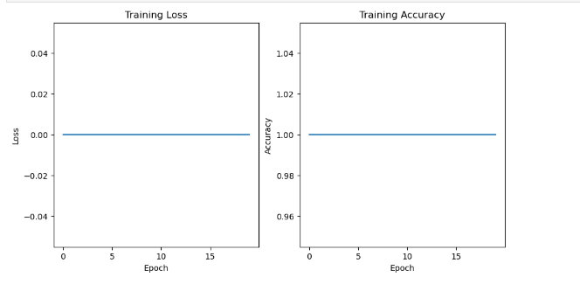
Performance Evaluation : MiniFaceRecognitionNetwork

Slide 9
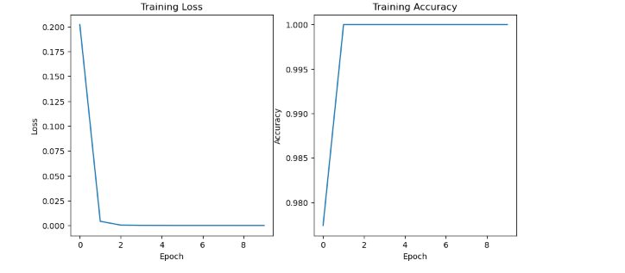
Performance Evaluation : ResNet-18

Slide 10
Models Comparison
Both the MiniFaceRecognitionNetwork and ResNet-18 models demonstrate remarkable performance in face recognition, achieving 100% accuracy on both training and testing datasets. They exhibit high precision, recall, and F1-score metrics, indicating their ability to effectively identify individuals. However, when comparing the two models, several factors need consideration. ResNet-18, being a pre-trained convolutional neural network originally designed for general image classification tasks, may offer advantages in terms of feature extraction from complex visual data due to its deeper architecture and extensive training on large-scale datasets like ImageNet. On the other hand, the MiniFaceRecognitionNetwork is tailored specifically for face recognition tasks, potentially offering superior efficiency and computational speed for real-time applications, given its optimized architecture and possibly smaller size. Additionally, while both models show comparable performance in this scenario, their suitability for different deployment environments and specific task requirements should be considered when choosing between them

Slide 11
Challeges
Facial recognition systems must contend with varying environmental conditions, including pose, lighting, expression, occlusion, and aging, which can introduce challenges to accurate identification.
Acquiring large, diverse datasets with high-quality annotations is essential for training robust facial recognition models, but it presents logistical and labeling challenges that impact performance.
Ethical considerations surrounding consent, privacy, and potential misuse necessitate responsible deployment of facial recognition technology with appropriate safeguards and transparency measures.
Addressing biases in both data and models is crucial to ensure fair and equitable outcomes in facial recognition applications, requiring careful consideration of demographic disparities and algorithmic fairness.

Slide 12
Cited Work
1. K. B. Pranav and J. Manikandan, "Design and Evaluation of a Real-Time Face Recognition System using Convolutional Neural Networks," *Procedia Computer Science*, vol. 171, pp. 1651-1659, 2020. DOI: [10.1016/j.procs.2020.04.177](https://doi.org/10.1016/j.procs.2020.04.177).
2. S. W. Arachchilage and E. Izquierdo, "A Framework for Real-Time Face-Recognition," in *2019 IEEE Visual Communications and Image Processing Conference*, IEEE.
3. Y. Esmail, M. Y. Shakor, P. Abdalla, "Deep Learning Based Real-Time Face Recognition System," *NeuroQuantology*, vol. 20, no. 6, pp. 7355-7366, June 2022. DOI: [10.14704/nq.2022.20.6.NQ22737](https://doi.org/10.14704/nq.2022.20.6.NQ22737).

